Slide 1
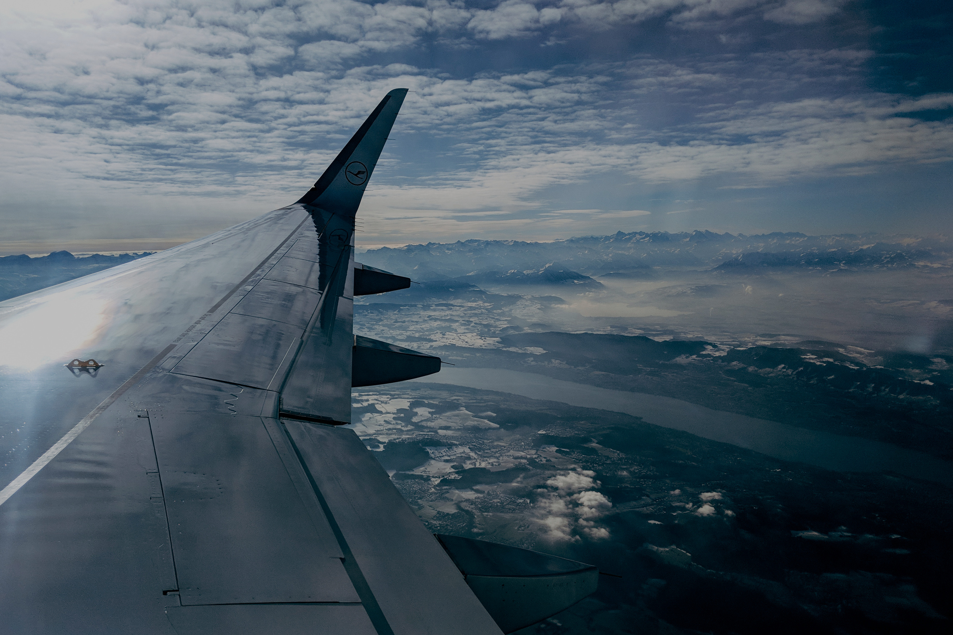

Aerospace
Aerospace
Aircrafts with Low Risk for Business Growth.
Author: Dennis Muriungi

Slide 2
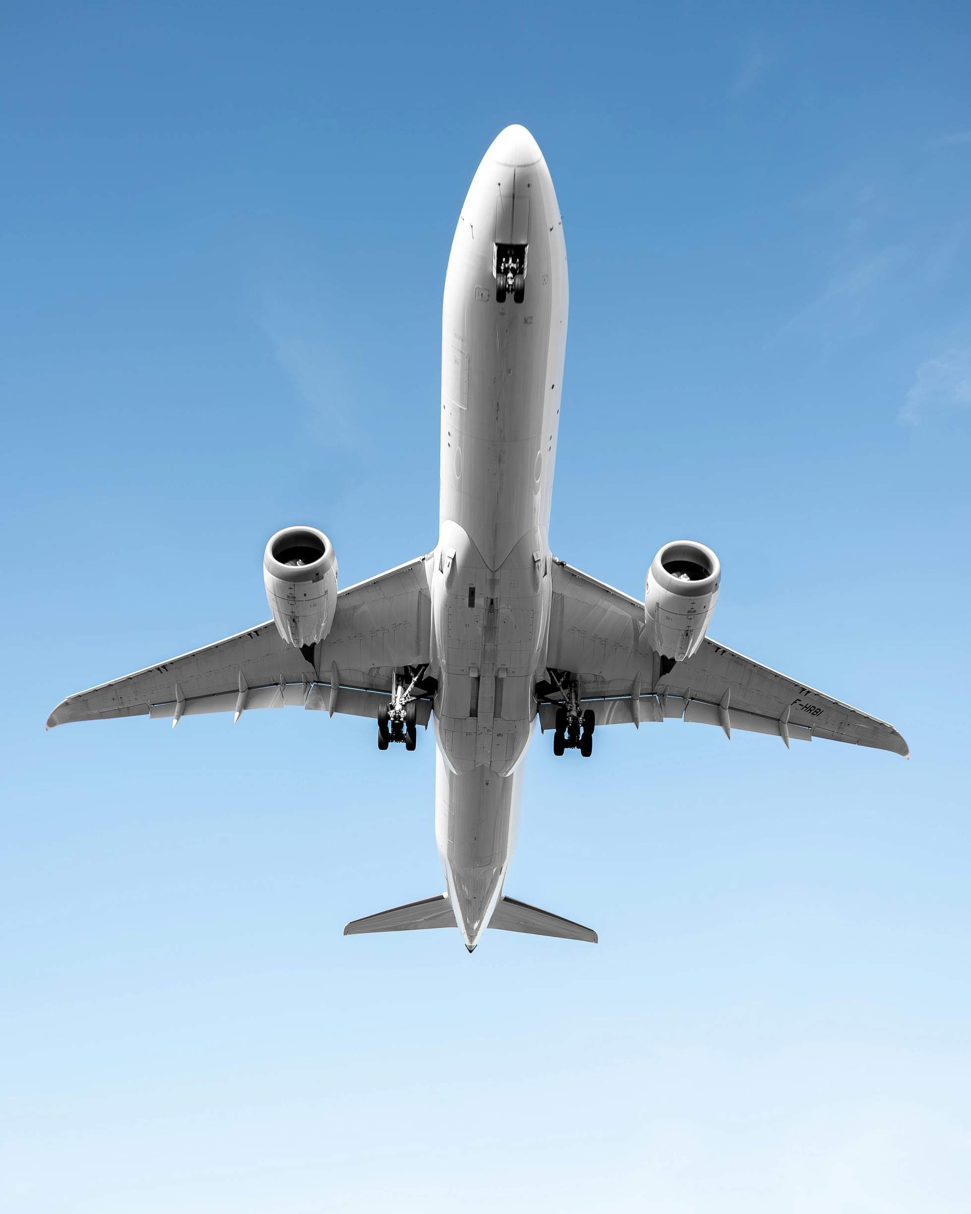
OVERVIEW
Commercial and private aviation businesses are growing.
Problem: What are the least dangerous aircraft types?
Information: Aviation Accident Dataset on Kaggle (1919–2023)
Techniques: Data cleansing, fatality analysis, accident scene analysis, and time trend analysis
Output: Data-driven suggestions for the safest aircraft to buy

Slide 3
BUSINESS PROBLEM
New to the aviation sector, the business seeks to lower risk.
Important queries:
1. Which kinds of aircraft have the fewest fatalities?
2. Where do the majority of accidents happen?
3. In what ways have accidents evolved over time?

Slide 4
DATA UNDERSTANDING
Source: Kaggle dataset of aviation accidents (23k+ records, 1919–2023)
Variables: date, type, operator, fatalities, location, country, cat, year, decade
Goal: Fatalities
Focus: Comparing the safety of commercial and private aircraft

Slide 5
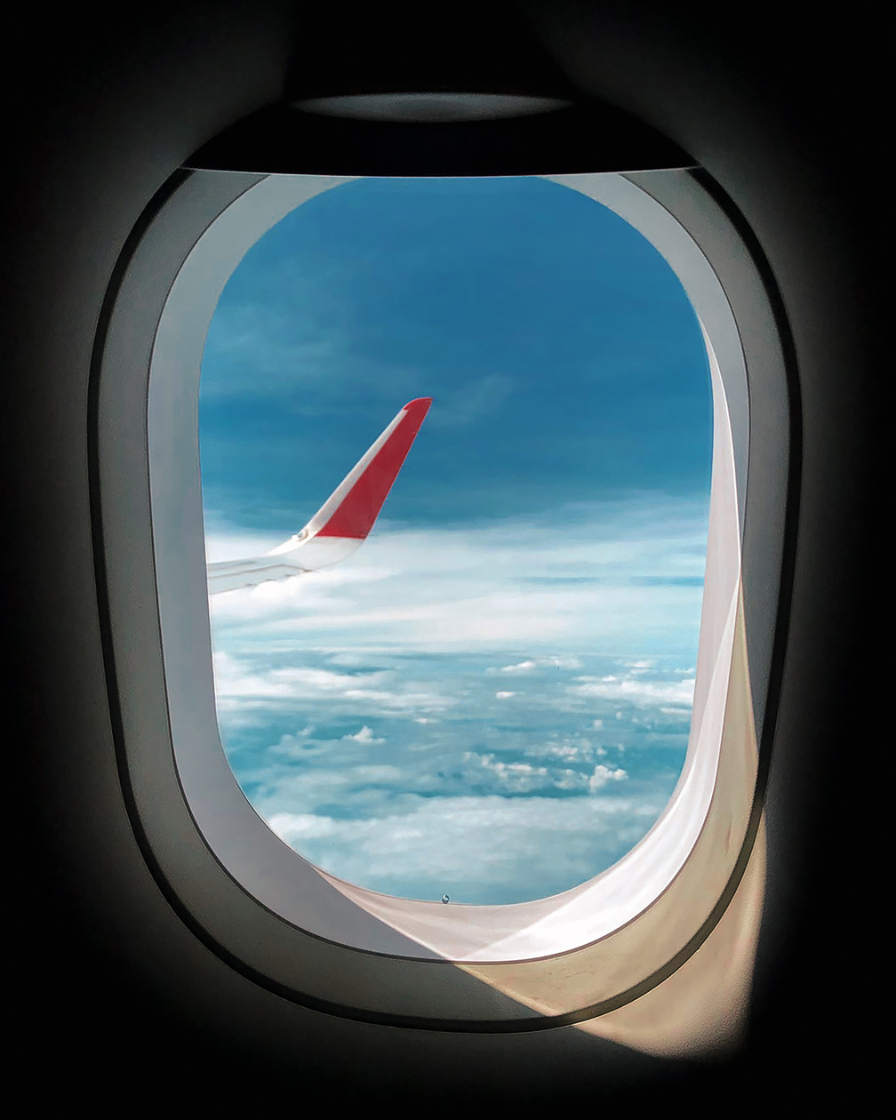
DATA CLEANING
115 rows of duplicates were eliminated.
Missing values have been fixed.
Limited year formats to 1919–2023)
Fatalities were converted to numbers for analysis.

Slide 6
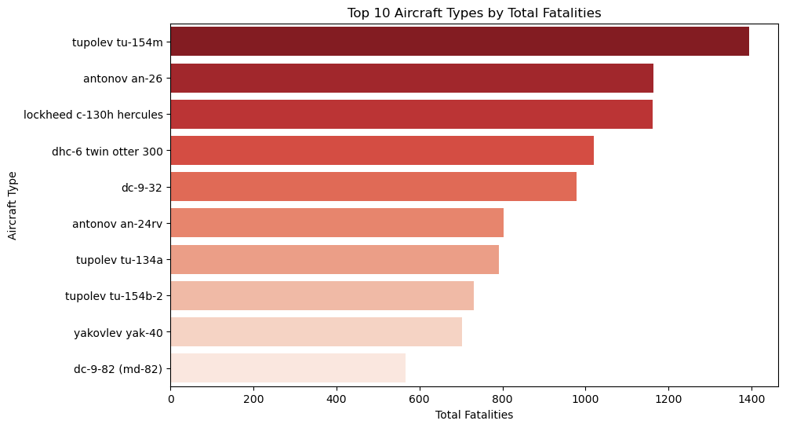
ANALYSIS 1 : TOP 10 AIRCRAFT TYPES BY FATALITIES
Focus on contemporary commercial jets that exhibit lower historical risk
rather than investing in antiquated models with high fatality rates.

Slide 7
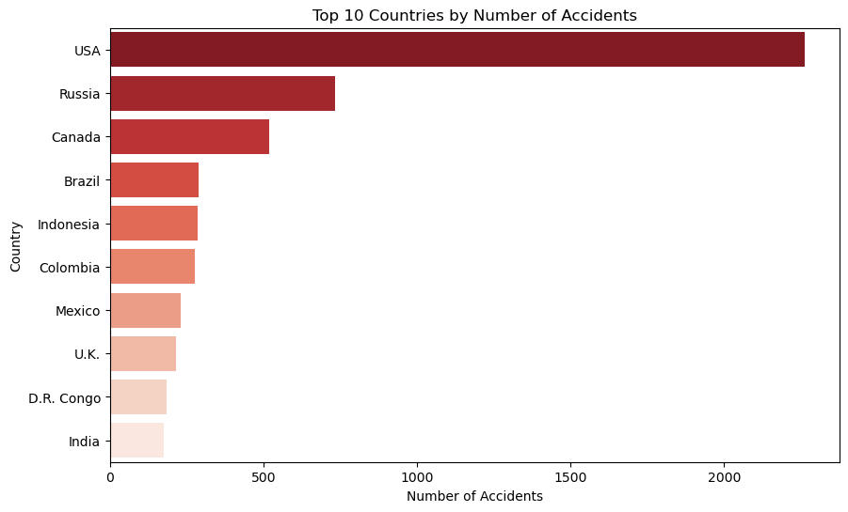

ANALYSIS 2 : LOCATION OF ACCIDENTS BY COUNTRY
WHEN GROWING OPERATIONS, THINK ABOUT CONCENTRATING ON NATIONS WITH STRICT AVIATION REGULATIONS
(LIKE WESTERN EUROPE) AND EXERCISING EXTRA CAUTION IN AREAS WITH A HISTORY OF MORE ACCIDENTS.

Slide 8
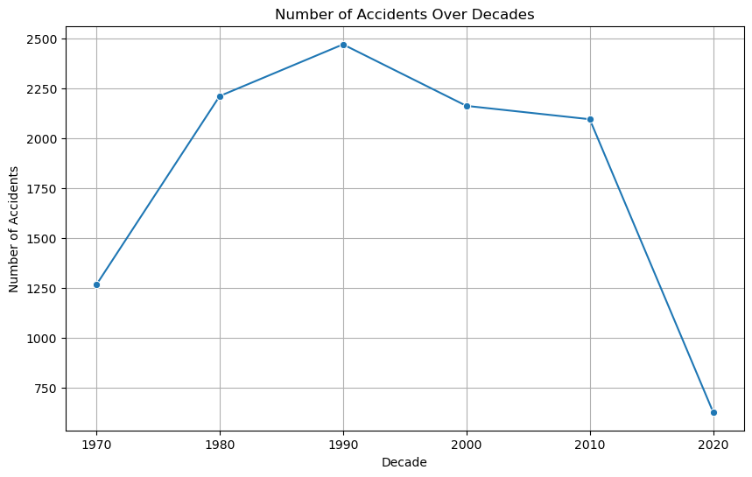
ANALYSIS 3 : THE TIME OF ACCIDENTS
Accidents have decreased in recent decades after peaking in the middle of the 20th century.
Because of technology and regulations, modern aircraft are generally safer.

Slide 9
RECOMMENDATIONS
Businesses Sector: Invest in more recent models of Boeing and Airbus for a lower risk and better safety record.
Private Sector: Modern Cessna aircraft and small jets have comparatively low fatal accident rates.
Focus on the Country: Steer clear of areas with historically elevated accident rates.

Slide 10


THANK YOU
Get In Touch!
dennis.muriungi2@student.moringaschool.com

